Slide 1
Re-Calibrating A “Place-Primacy” in Public Policy:
Rural Communities, Rural Regions and the Rural-Urban Continuum
Presented to
The Maryland Rural Health Association:
Rural Matters: Emerging Health Challenges and Opportunities
Cumberland, Maryland
October 21, 2010
Charles W. Fluharty
President & CEO
Rural Policy Research Institute

Slide 2
Today’s Considerations
Validating the messenger and framing this dialogue
Rethinking the urban/rural dichotomy, toward a more regional framework for policy targeting
The New Rural Paradigm (NRP): an OECD perspective on Regional Rural Innovation
The current U.S. policy dynamic
New rural imperatives, given these dynamics
The critical role of rural health care
Final reflections

Slide 3
I. Validating the messenger
and framing this dialogue

Slide 4
II. Rethinking the urban/
rural dichotomy, toward a more regional framework for policy targeting

Slide 5
A Place-Based Policy Framework Focused Solely on Metropolitan Geography Masks Critical Realities:
While metropolitan areas account for over 80 percent of the total population, they account for only 25.7 percent of total land area.
A metropolitan focus for place-based programs ignores critical linkages with three-quarters of the U.S. natural resource base, and the 20 percent of the population which steward these national treasures.

Slide 6
Nonmetropolitan America Includes Urban Centers
60% of nonmetropolitan residents live in micropolitan areas, which include a regional center of 10,000 to 49,999 people.
These areas are logical hubs for the emergence of national regional innovation strategies, encompassing workforce, eco-system, health and human services, and retail service infrastructures.

Slide 7

Where are all the rural people?
5 states account for 25 percent of all rural people
  Texas (3.6m)
  North Carolina (3.2m)
  Pennsylvania (2.8m)
  Ohio (2.6m)
  Michigan (2.5m)
The “most rural” states only account for only 6.7% of rural population
  Vermont (61.8% rural)
  Maine (59.8% rural)
  West Virginia (53.9% rural)
  Mississippi (51.2% rural)
  South Dakota (48.1% rural)

Slide 8
Definitions of Rural are Imprecise
OMB designations of Core Based Statistical Areas are based on urban centers and the commuting relationship with those centers
“Metropolitan” doesn’t equate with “urban,” and “nonmetropolitan doesn’t equate with “rural.”
Most “rural” people live in “metropolitan” counties – 51 percent.
However, the precise definition of rural and urban does not work well for policy targeting
Difficult to find a good middle ground that describes the continuum

Slide 9
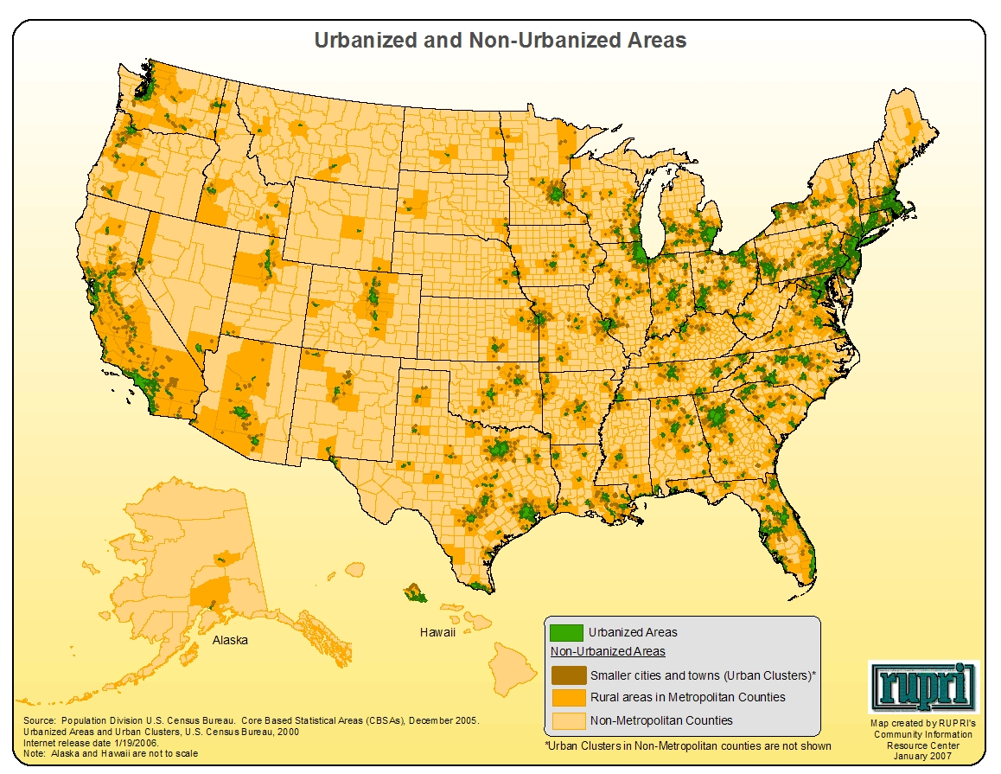
Metropolitan Areas are Both Urban and Rural

Slide 10
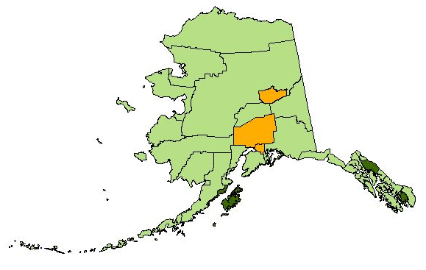
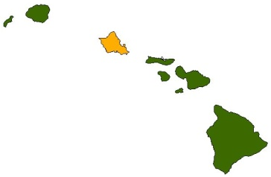
Core Based Statistical Area Classifications, 2008
CBSA Classification
Metropolitan
Micropolitan
Source: Office of Management and Budget and
U.S. Census Bureau
Alaska & Hawaii are not to scale
Noncore

Slide 11
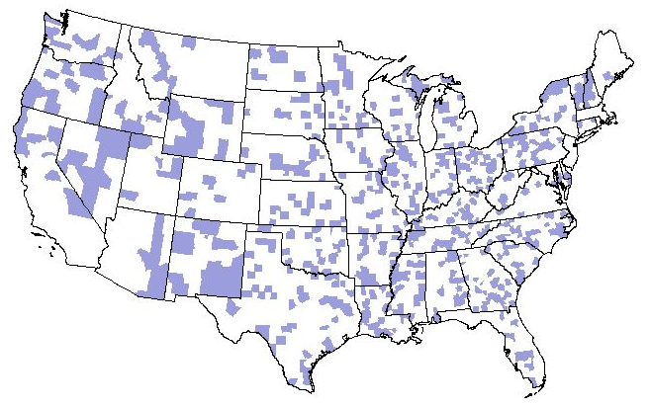
Micropolitan Counties, November 2008
686 Counties in 574 Micropolitan Areas
Source: Office of Management and Budget; and U.S. Census Bureau

Slide 12
48.8 million people live in nonmetropolitan counties +
40.5 million people live in metro counties outside urbanized areas
➔ 89.3 million “rural” people

Slide 13
A “Rural” Example:
Kansas and Topeka

Slide 14

Metropolitan and Nonmetropolitan Areas,
and Urban Areas in Kansas
CBSA Status
Urban Areas
Metropolitan
Micropolitan
Source: Office of Management and Budget, Core Based Statistical Areas, November 2008
Noncore

Slide 15
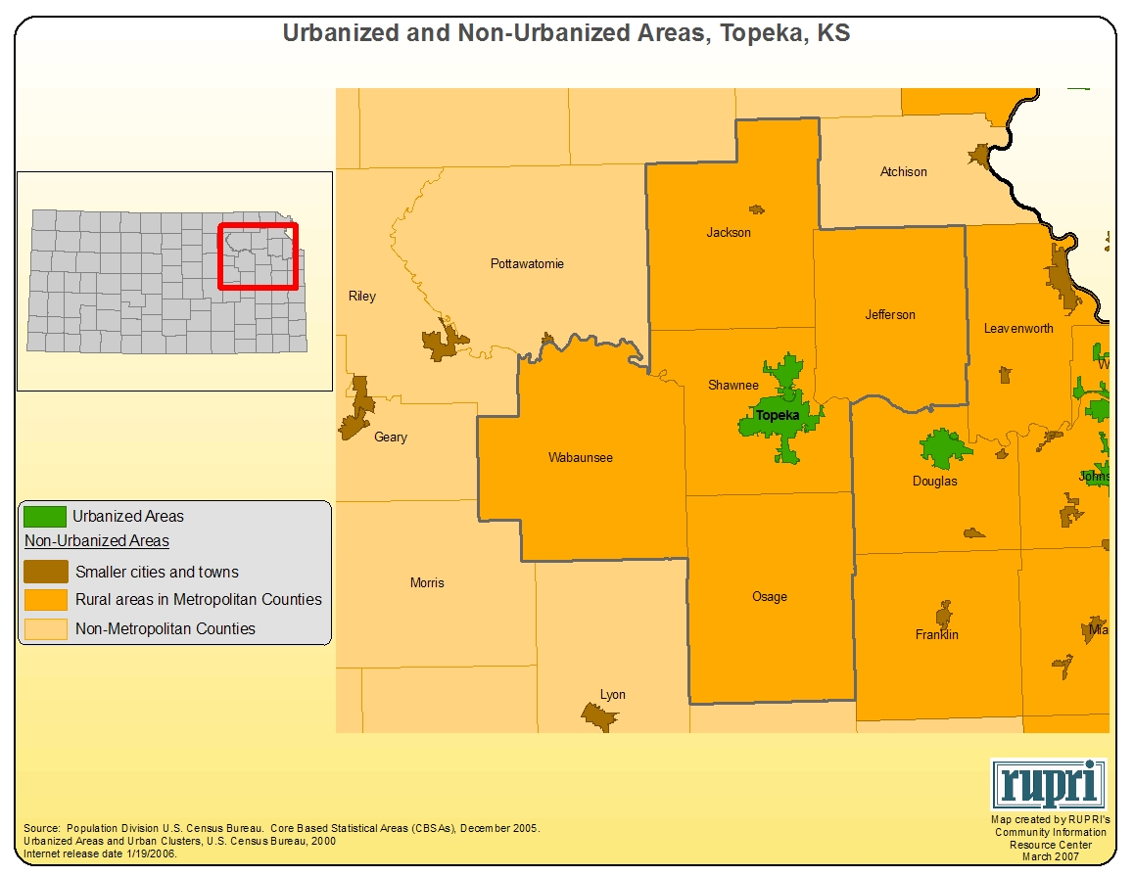

Slide 17
III. The New Rural Paradigm (NRP): an OECD perspective on Regional Rural Innovation

Slide 18
What is Rural Policy for OECD?
Not a coherent set of policies and programmes – amalgam of independent pieces that have evolved through time.
2 levels
    Narrow Rural Policy – those policies that are designed to explicitly affect rural areas – agriculture, rural broadband, rural doctors
    Broad Rural Policy – those policies that have no specific geographic focus, but have major rural impacts – national health insurance, education policy, investment policy

Slide 19
Rural policy evolves
Several factors influence rural policy
  Agriculture has become a minor source of income and employment in OECD rural areas.
  Role and condition of manufacturing in rural areas (globalisation is both an opportunity and a challenge).
  Rural residents demand the same services offered in urban areas
  Competition for scarce public resources requires evidence that expenditures have a clear value

Slide 20
Analysis evolves
Average annual growth rates in OECD TL3 1995-2005
Predominantly rural
Predominantly urban

Slide 21
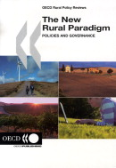
The New Rural Paradigm (NRP)
 | Old Paradigm | New Paradigm
Objectives | Equalization, focus on farm income | Competitiveness of rural areas
Key target | Sector based | Holistic approach that includes various sectors of rural economies
Main tools | Subsidies | Investments
Key actors | National governments, farmers | Multilevel-governance
Objectives of NRP:
- Guarantee adequate attention to rural issues
- Empower local communities and governments

Slide 22
Acceptance of the NRP
All countries see merit in the NRP as an enhancement to current rural policy
Movement away from subsidies limited by:
  Difficulty in identifying sound investments;
  Vocal minority defends the subsidy approach;
  Mismatch between what national agencies can manage and the demands of a bottom-up process (LEADER example).

Slide 23
Convergence of rural issues
Little employment in agriculture
Demography
  Dropping birth rates and youth outmigration
  Population increases depend on retirees, low-skilled foreign workers
  Rural represents 20% of the national population
Public services – demand and delivery
Protection of natural resource (amenities)
  Natural resources have an “existence value”
Economic restructuring
  Changing comparative advantage and economic function of rural areas
Climate change, and availability of energy

Slide 24
Common strategies (1)
Entrepreneurship and self employment
Amenity based tourism (nature/culture)
Care for the elderly (longevity/silver economy)
High value agriculture (local food)
Renewable energy
Emerging development strategies in rural areas
Notes:
In the US, entrepreneurship, innovation and amenities are considered as the means to drive rural growth, post crisis.

Slide 25
Common strategies (2)
Almost all renewable energy is rural
Renewable energy may be a 3-in-1 solution for
  Climate change
  Employment
  Boosting rural investment
Green economy is seen as a development opportunity for rural areas

Slide 26
Common policy threads (1)
In the aggregate, rural economies are seen as similar to urban regions.
However, below the aggregate level, there are different types of activities, skills utilized, value-added, wage levels and organizational complexity.
In some cases, the difference between rural and urban economies is not considered

Slide 27
Common policy threads (2)
Focus of most rural policy is on remote rural areas.
Very little policy targets peri-urban areas or more intermediate regions, even though the majority of the rural population is found in these places.
Need for a focus on intermediate regions and urban-rural linkages

Slide 28
Conclusions
The rural context is important.
Commonly desired outcomes for rural areas exist but different political structures, social values, rights, etc. constrain policy choices.
Place-based evaluation can play a key role in examining the performance of projects and programmes.
There is scope for mutual learning for policy dialogue – OECD.

Slide 29
Specific EU Considerations
The Rural/Regional Development Policy Issue
The Ag/Rural Development Continuum
Social Cohesion Funds in Regional Development Policy
Culture Trumps Everything!

Slide 30
IV. The current
U.S. policy dynamic

Slide 31
Policies and budgets are ultimately about visions and values.

Slide 32
“The social and economic institutions of the open country are not keeping pace with the development of the nation as a whole . . . ”
- President Teddy Roosevelt’s
Country Life Commission

Slide 33
“If you do the same things, over and over, you’ll probably get the same outcomes!”

Slide 34
Reframing the Question:
“ What policy framework will best integrate rural and urban initiatives and programs, to advantage both constituencies, their communities and regions, and enhance their children’s potential to thrive there in the 21st century?”

Slide 35
The Critical Role of Intermediaries
“Intermediaries are people and institutions that add value to the world indirectly, by connecting and supporting – i.e., by enabling others to be more effective. Intermediaries may act as facilitators, educators, capacity builders, social investors, performance managers, coalition builders, and organizers of new groups.”
        Xavier de Souza Briggs
        The Art and Science of Community Problem-Solving Project
        Kennedy School, Harvard University, June, 2003.

Slide 36
Three Critical Questions
Will public sector champion(s) step forward?
Will institutional innovator(s) accept the challenge of building new intermediary structures?
Will new constituencies arise to jointly support these innovative leaders and institutions?

Slide 37
Five Critical Institutional Challenges
Rethinking core missions
Redefining roles and responsibilities
Creating a renaissanced leadership cadre, who become change agents.
Engaging and supporting the “border crossers!”
Redefining “we” and “they,” with special attention to diversity, cultural and social inclusion.

Slide 38
Today, intermediaries are more critical than ever:
The recession, and the lagging economic recovery which will only slowly come to central city and rural areas.
Federal ARRA funds are gone next year.
State and local governments are already operating under historic budget deficits,
While human services needs expand exponentially.
The comity within our public discourse, and the tempering center of our body politic, both continue to erode.

Slide 39
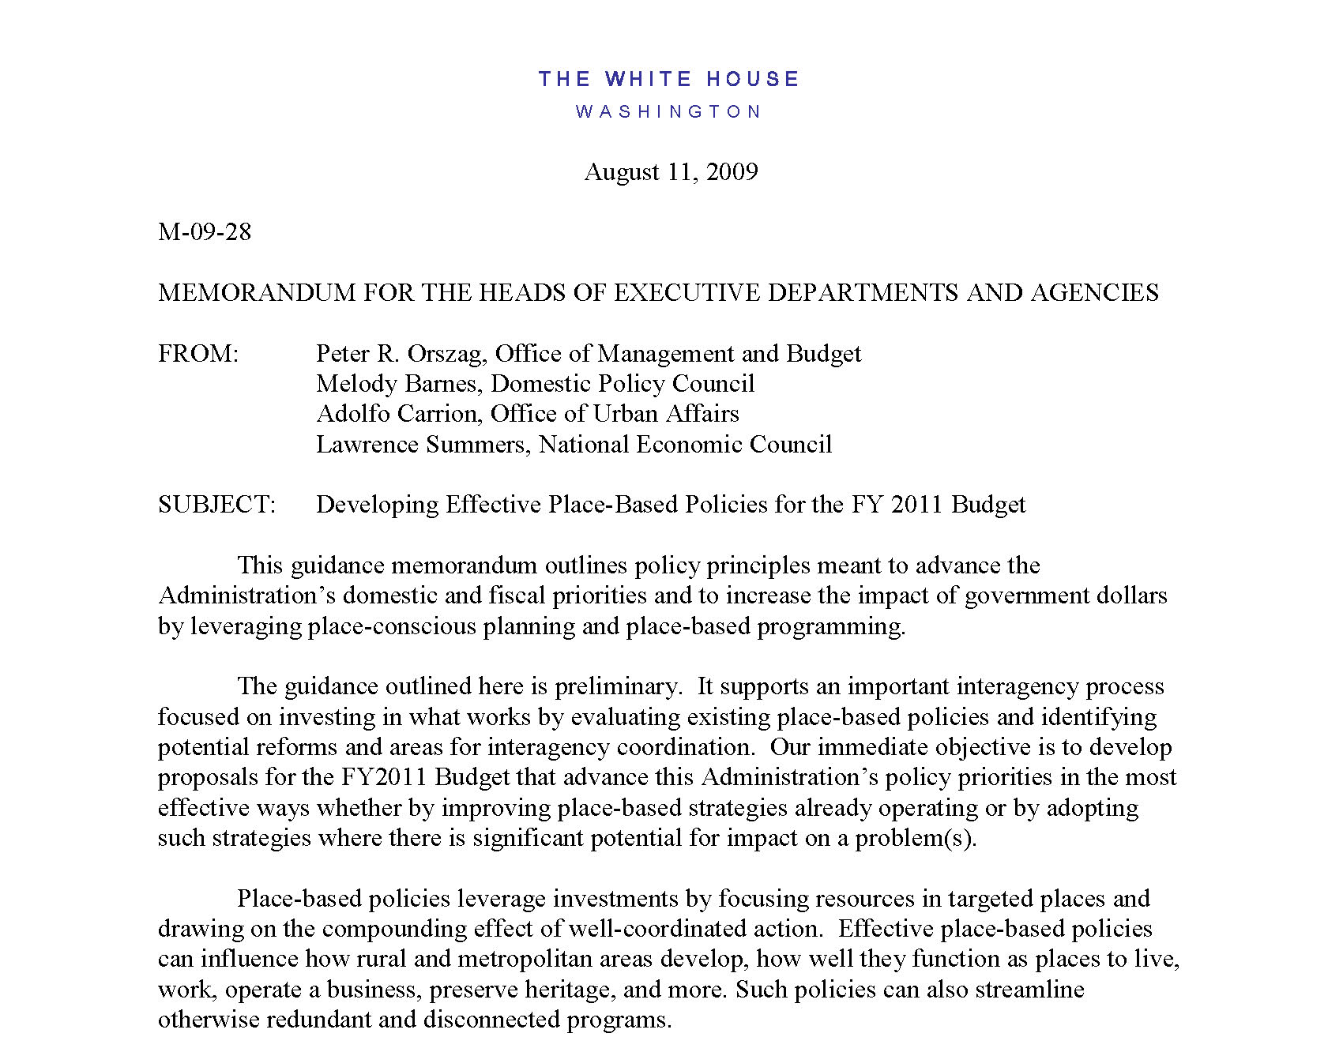

Slide 40
“…Many important challenges demand a regional approach. The Nation is increasingly a conglomeration of regional economies and ecosystems that should be approached as such. Federal investments should promote planning and collaboration across jurisdictional boundaries. Given the forces reshaping smaller communities, it is particularly important that rural development programs be coordinated with broader regional initiatives. Programs in neighboring zones and within larger regions – some of which connect rural communities to metropolitan regions – should complement each other. Federal programs should reflect better the Nation’s economic and social diversity, both in rural and metropolitan areas. To the extent possible, programs should allow for communities to identify distinct needs and address them in appropriate, strategic ways…”

Slide 41
Achieving this will Demand:
Greater attention to asset-based development, much more broadly defined.
The building of regional frameworks, appropriately configured, of sufficient scale to leverage these geographies and bridge these constituencies. (While we need rural and urban responses, their intersection is the future of enlightened public policy.)
As the Federal role reduces over time, greater attention to new governance / new intermediary support by the public sector.
Regional innovation policies which specifically target mutually beneficial competitive advantage, that rural and urban areas share. (i.e., Regional food systems, bio-energy compacts, natural resource-based / sustainability assets, “workshed” / “watershed” approaches, etc.)

Slide 42
Achieving this will Demand (cont.):
Attention to the importance of working landscapes:
  Arts / heritage / culture
  Natural resources / tourism
  Bio-energy / biofuels, entrepreneurial agriculture
Incentives to bridge innovation / entrepreneurship support systems, from urban to rural expression
Opportunities to address spatial mismatch issues in workforce / training across broader geographies, via “place-based” community / technical college collaborations, both sister schools and research universities.
Innovative funding approaches which enhance collaboration across state and local governments, particularly in cross-sectoral, regional experimentation.

Slide 43
V. New rural imperatives given these dynamics

Slide 44
“Would you tell me, please, which way I ought to go from here?”
“That depends a good deal on where you want to get to,” said the cat.
“I don’t much care where,” said Alice.
“Then it doesn’t much matter which way you go,” said the cat.
Lewis Carroll
Alice’s Adventures in Wonderland

Slide 45
“If the misery of the poor be caused not by the laws of nature, but by our institutions, great is our sin.”
Charles Darwin

Slide 46
“It is not enough, to know,
one should also use;
it is not enough to want,
one should also act.”
Goethe

Slide 47
“No snowflake in an avalanche
ever feels responsible!”
Stanislaus Lezcynski

Slide 48
Dynamics That Will
Impact All Rural Regions
The rural economic lag in exiting this recession, and the cessation of ARRA federal investments
  State and local public budget crisis
  The necessity of new governance approaches to create wiser public investment strategies
Entrepreneurial agriculture innovation
Health, higher education, and broadband technology linkages

Slide 49
The continuing move from rural-urban dissonance to rural-urban interdependence
  Renewable energy systems
  Community and regional food systems
  “Sense of Place” cultural, ecosystem, and amenity tourism
  Climate change mitigation and adaptation / natural resources
The extent to which rural areas address social inclusion and social equity considerations in their innovation approaches
The attention paid to human and social capital development (education, workforce training, poverty and hunger alleviation approaches)

Slide 50
Federal Policy Innovations That Can Truly Matter to Rural Areas
The Obama Administration’s commitment to “Place-Based” policy (August 2009 White House memo)
USDA’s Rural Innovation Initiative (NOFA)
The HUD/EPA/DOT Sustainable Community Partnership (NOFA)
The new Farm Bill framework
State policy innovations emanating from these opportunities

Slide 51
Some “Must-Do’s,” If Rural Regions Are to Actually Shape Their Own Futures
Believing in and validating your “rural” commitments
Rethinking the “we” and “they” dynamics within your rural place
Building and/or aligning regional governance platforms
Supporting innovation, entrepreneurship, and local wealth creation
Building scale appropriate innovation systems, without losing focus on the importance of community (private/public/social)
Committing to the long haul
Celebrating your “quality of place”

Slide 52
Things to Keep in Mind:
There are no silver bullets!
Things take time, but this fiscal and budgetary environment will pass: measured urgency to capture the moment must be the cadence
What works elsewhere should only provide encouragement, and should not necessarily be your region’s innovation approach

Slide 53
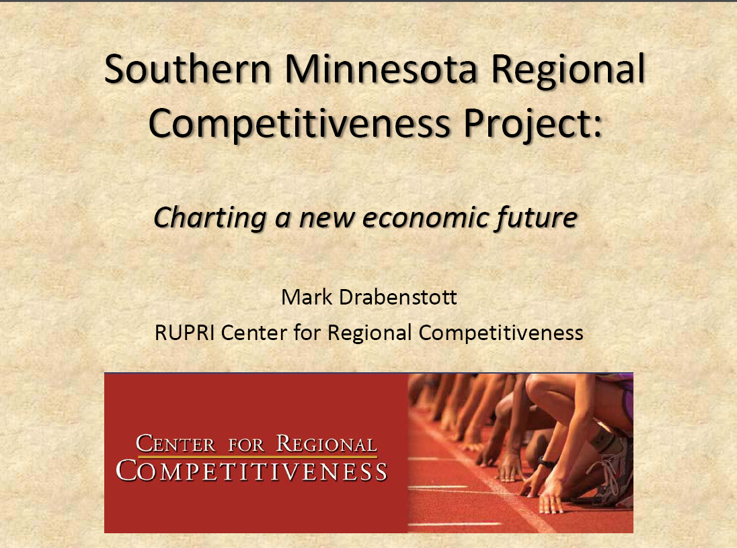

Slide 54
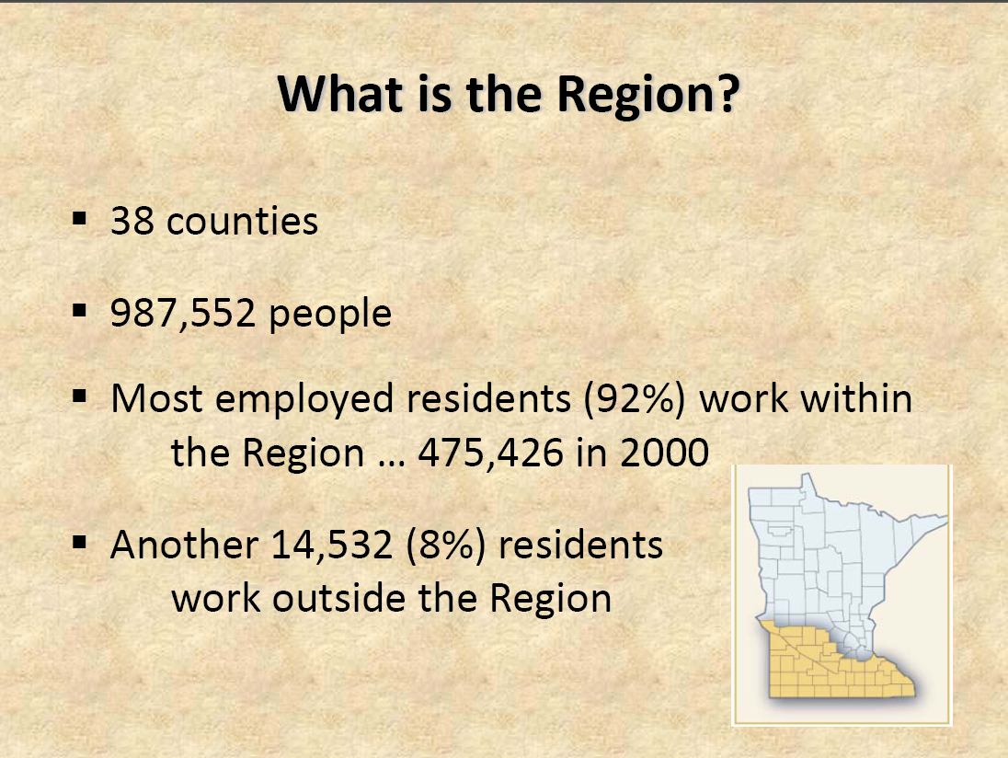

Slide 55
The Framework for Regional Rural Innovation
New Narratives & Networks
Quality of Place
Collaborative Leadership
Knowledge Networks & Workforce
E-ship & Innovation
Critical Internal Considerations
Wealth Creation and Intergenerational Wealth Retention
Youth Engagement and Retention
Social Inclusion and Social Equity

Slide 56
VI. The critical role
of rural health care

Slide 57
VII. Final reflections

Slide 58
“What lies behind us,
and what lies before us
are tiny matters
compared to what lies within us.”
--Ralph Waldo Emerson

Slide 59

Charles W. Fluharty
cfluharty@rupri.org
President and CEO
Rural Policy Research Institute
214 Middlebush Hall
University of Missouri
Columbia, MO 65211
(573) 882-0316
http://www.rupri.org/

