Slide 1


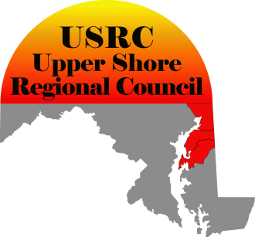
Maryland Telehealth and Telemedicine (THTM) Survey
Rural Maryland Council
Maryland Rural Health Association
Upper Shore Regional Council

Slide 2

What is Telehealth?
Telehealth: the use of electronic information and telecommunications technologies to support long-distance clinical health care, patient and professional health-related education, public health and health administration.
Notes:
Human Services and Resources Administration definitions of telehealth and telemedicine.

Slide 3
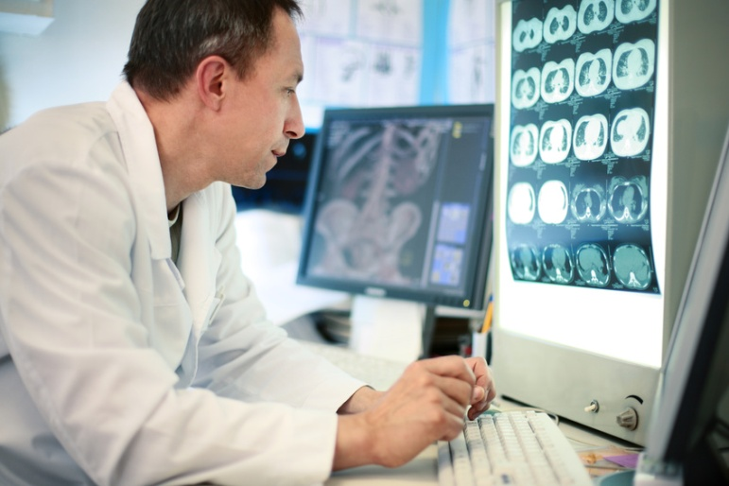
What is Telemedicine?
Telemedicine is the use of electronic communication: diagnosis, treatment, transfer of medical clinical data. Many describe telemedicine in subspecialties like telemental health, telecardiology, and teledentistry.
Notes:
Telemedicine is a subset of telehealth.

Slide 4
History
2007 – Maryland Rural Health Plan identified access to primary and specialty care as the number one priority for a healthy rural Maryland.
2007-08 – Maryland Rural Health Association and the State Office of Rural Health holds a series of listening sessions in rural Maryland.
2009 – Maryland Rural Health Implementation Plan identified the expansion and enhancement of telehealth as the second highest priority for increasing access to specialty care for rural areas.
2009 - Rural Maryland Council holds a Telehealth Roundtable..
  Conclusion: a statewide inventory of telehealth projects needs to be done.
2009/10 – RMC, MRHA and USRC undertakes Inventory.
Notes:
In response to the Number one strategy2008 – Senate Bill 459 created the Task Force to Review Physician Shortages in Rural Areas.
2009, Senate Bill 627 created a Loan Assistance Re-Payment and Practice Assistance for Physicians.
2010 during the last legislative session, House Bill 319 reducing some of the barriers that allow Nurse Practioners to provide care without a collaboration physician.

Slide 5
Rural Maryland Council
Maryland Rural Health Association
Upper Shore Regional Council
Survey: Compilation of an accurate inventory of telehealth and telemedicine projects underway in Maryland.
    Funded by the Maryland Agriculture Education and Rural Development Assistance Fund (MAERDAF).
Notes:
Rural Maryland Council’s Health Care Working Committee and Telehealth Subcommittee recommendation for this study led to the Upper Shore Regional Council receiving a MAERDAF Grant to conduct the study.
We believed that other states may be ahead of us in introducing telehealth and that we may be behind other states in obtaining federal funds for telehealth and telemedicine.
There have been no grants for Maryland from the Office of Advancement of Telehealth within the Department of Health and Human Services.
USDA’s Rural Development Distance Learning and Telemedicine last grant to Maryland was in 2003 to Sheppard Pratt.
The FCC’s Rural Healthcare Pilot Program awarded 69 grants in 42 states with none in Maryland.
We have received a copy of relatively minor Broadband grants and still waiting to hear about the State’s major broadband proposal from the NTIA.

Slide 6
Survey
Goal:
  Identify TH/TM projects underway in Maryland.
Purpose:
  Advance reimbursement of services;
  Support credentialing and licensing;
  Increase access to care in rural communities;
  Inform statewide policy and implementation in coordination with the statewide Health Information Exchange initiative in Maryland.
Notes:
We hope to bring those providing service and those receiving services together to:
better coordinate efforts,
Provide a foundation for compatible infrastructure,
Address key issues,
Reduce future potential redundancy,
Encourage future increased funding to support and expand services.
Note – we’re not looking at Electronic records. Maryland has a Health Information Technology State Plan to build a statewide Health Information Exchange. We’re more concerned with applying technology for delivering health information and providing medical services.

Slide 7

Who we targeted?
137 organizations
  All hospitals in Maryland
  Maryland Federally Qualified Health Centers
  University of Maryland School of Medicine
    Along with individual departments
  Johns Hopkins Health System
    Along with individual departments
  Local Health Departments
  Department of Public Safety and Correctional Services
  Department of Health and Mental Hygiene
Notes:
24 of our targets responded.
15 completed the survey.
14 stated they had no telemedicine projects.
Over 100 did not respond.

Slide 8
Participants
Atlantic General Hospital
Calvert Memorial Hospital
Chester River Hospital
Dorchester County Health Department
Johns Hopkins Medicine
Johns Hopkins Schools of Nursing and Medicine
Mid Shore Mental Health Systems
Sheppard Pratt
St. Mary's Hospital
University of Maryland
University of Maryland Medical System
University of Maryland School of Medicine
Western Maryland Health System
Western Maryland Health System
Wicomico County Health Department
6 Hospitals
4 Health Departments
2 Medical Schools
2 Mental Health Facilities
Notes:
Despite the low numbers, we were pleased with the quality of the responses and the particular organizations who participated.
Survey continues and can be accessed at the Rural Maryland Council website.

Slide 9
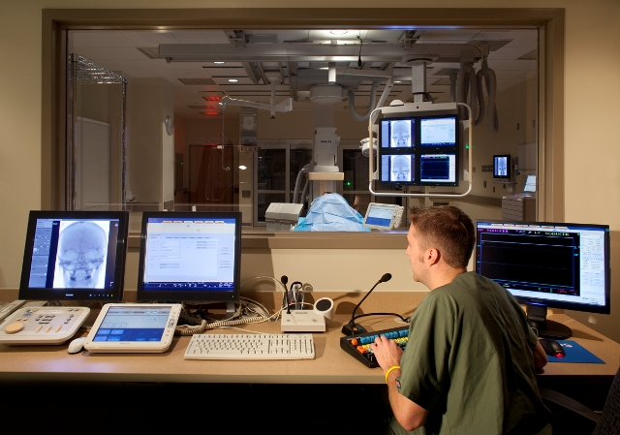
Major TH/TM Projects Identified
Western Maryland Health System
  Western Maryland Regional Medical Center
  Univ. of MD Cancer Center
  Sheppard Pratt
  And others
Cardiology, Emergency services, Mental Health and Radiology.
  via web based software.

Slide 10

Major TH/TM Projects Identified
Sheppard Pratt Health Systems
  Providing health diagnostic services and medication management to lower shore county partners.
  Funding originally through HRSA and USDA
    Now locally funded.

Slide 11

Major TH/TM Projects Identified
University of Maryland School of Medicine.
  MAPSS Perinatal Telemedicine Project
  Partners: Union Hospital, St. Mary’s Hospital
Provides patient management in OB/GYN and perinatal genetic counseling through interactive video.

Slide 12


Major TH/TM Projects Identified
Johns Hopkins Medicine
  Remote Access in Otolaryngology
  Imaging, patient management, and diagnostic services via desktop software and robotics.
Notes:
Otolaryngology is head and neck. (ear, nose and throat)

Slide 13

Major TH/TM Projects Identified
Maryland Telepsychiatry Network Program
  Mid Shore Mental Health Systems & others
  Provides mental health diagnostic and patient management through interactive video.
 | Mid-Shore Mental Health Systems, Inc. Excellence in Public Mental Health

Slide 14
Major TH/TM Projects Identified
Verizon Emergency Department Robot Project (Verizon Foundation)
  Johns Hopkins Medicine Center for Innovation in Quality Patient care.
    Neurology and linguistic translation via interactive video and robotics.
Notes:
remote-presence robot to reduce the time patients must wait for
consultations by clinical specialists. Using laptop computers that
control a robot in the ED, on-call specialists can respond to requests
for assistance immediately from wherever they may be (another location
in the hospital, across the city, or elsewhere).

Slide 15

Major TH/TM Projects Identified
Maryland eCare
  Christiana Hospital, Union Hospital, Atlantic General, Calvert Memorial, Civista Medical Center, St. Mary's Hospital, Peninsula Regional Medical Center, Washington County Health System.
  Provides clinical critical care patient management and monitoring for Intensive Care Unit patients.

Slide 16

Major TH/TM Projects Identified
Pediatric Diagnostic Telemedicine Project
  St. Mary’s Hospital; Children’s National Medical Center
  Pediatric cardiology and neurology services

Slide 17

Major TH/TM Projects Identified
Maryland Telehome Care Network
  University of Maryland Medical System (UMMS);
  Partners: Garrett County Health Department; Chesapeake-Potomac Home Health Agency; Eastern Shore AHEC; & Western MD AHEC.
  Chronic disease management through handheld wireless monitoring devices and interactive video in the homes of patients.

Slide 18
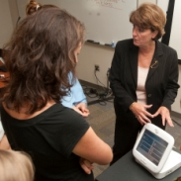

Major TH/TM Projects Identified
Telehome for Community Dwelling African Americans.
  Johns Hopkins School of Nursing
    Cardiology and chronic disease management using Intel Health Guide Telemonitoring and telehomecare device.

Slide 19
Distribution of Surveyed TH/TM
Clinical Services
Notes:
This chart told us what you are using telemedicine technology to do. Mental health applications had the greatest number of responses which may relate to a greater ability to be paid for services performed over the internet. Cardiology and neurology followed. ICU was the lowest response but I suspect that may be misleading as this is a growing area and I know, for example, that Christiana Care in Delaware is partnering with some of our hospitals on Tele-ICU. (Atlantic General in Berlin and Calvert Memorial in Prince Frederick, for example and, I believe, Union Hospital just went on line with the program.)

Slide 20
Procedures of Surveyed Projects

Slide 21
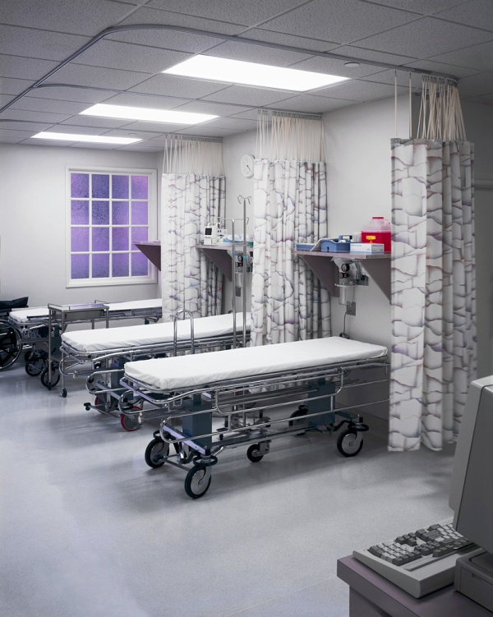

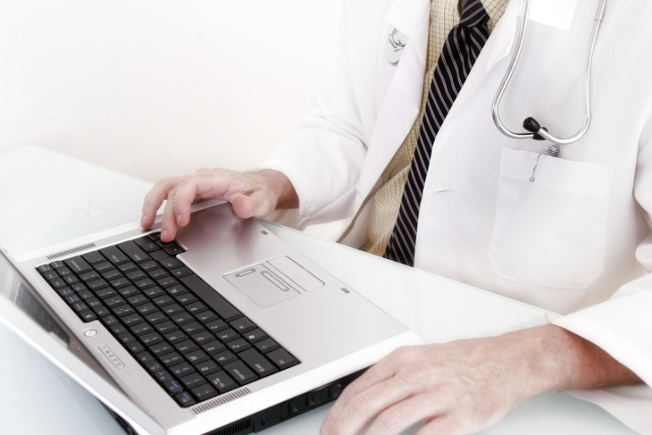
General Benefits of TH/TM
Patient satisfaction
Provider satisfaction
Decreased length of hospital stay
Notes:
Respondents were asked to cite stories showings the impact of telehealth – Results:
Quality of care
Travel of sick patients reduced – 6 hours per day in the cited case.
Specialist available now where none was previously.
Psychological evaluation time reduced from 6 weeks to 2 weeks.
Less emergency visits of prison inmates and non-emergency nature patients.
Allowing children less absence from school.

Slide 22
Reported improvement to delivery of care
Notes:
“Other” includes access to specialist provider care; project is pending, new and too early to tell.

Slide 23

Cited barriers to TH/TM
Reimbursement
Credentialing of Providers
Cost of equipment
High administrative cost
Interactive video

Slide 24

Priorities for Maryland
Reimbursement and Financing
State leadership
Broadband Access
Reimbursement of Private payers
Licensing and credentialing

Slide 25

Discussion/Questions?

