Slide 1
Brian J Grady, M.D.
Assistant Professor
Director TeleMental Health
School of Medicine
University of Maryland
6 Dec 2010
Development of State TMH Regulations in Maryland
New Telehealth Reimbursement Regulations
Telemental Health Services
COMAR 10.21.30.*
Notes:
1

Slide 2
Disclosure

Slide 3
TMH in Maryland
Background
1998 Naval Hospital Bethesda begins TMH Service Delivery
2002/3 UMB Center for School Mental Health/ Statewide Telehealth Network (STN) /Baltimore Schools - Addiction Education
2002 Correctional Mental Health founded, TMH services begin …?
2005 UMB/JHU Maryland Youth Practice Improvement Committee (MYPIC) conducts case conferences via video (STN)
2005 Sheppard Pratt Health System begins TeleBehavioral Services Delivery
2005 Veteran Health Administration begins TMH Delivery to Maryland
2007 UMB begins TMH Services Delivery

Slide 4
The Public Mental Health System TMH Working Group
Working group convened in Fall 2007 by
Mental Hygiene Administration
Executive Director to Draft Regulations
  University of MD School of Medicine
  Sheppard Pratt Health System
  Department Health and Mental Hygiene
  Core Service Agency Representatives
  Maryland Psychiatric Society
  Correctional Mental Health
  Other interested parties

Slide 5
The Drafting Process
Initial guidance
  Limited to Psychiatry
  Most rural counties
Group met via video and audio conferencing
Used yahoo group site to discuss and share information >
Group started with review of existing regulations and legislation

Slide 6
Medicare
    Balanced Budget Act (BBA) of 1997
      Fee Sharing 75/25; Telepresenter; HPSA
    Benefits Improvement and Protection Act of 2000 (BIPA)
      No Fee Sharing/Telepresenter; expanded office types & treatment
      Originating Site Facility Fee, 80% actual cost or up to $20.00 (for 2010 >)
    CMS Expansion 2009
      Skilled Nursing Facilities and CMHC
    Credentialing Changes May 2010 (JCAHO) ref

Slide 7
Medicaid
  Types
    Legislative
    Regulatory
    Pilot
  States with some form of Medicaid reimbursement 35 (2009)

Slide 8
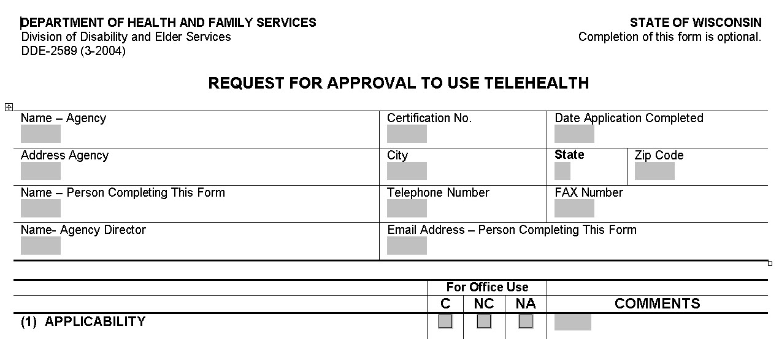
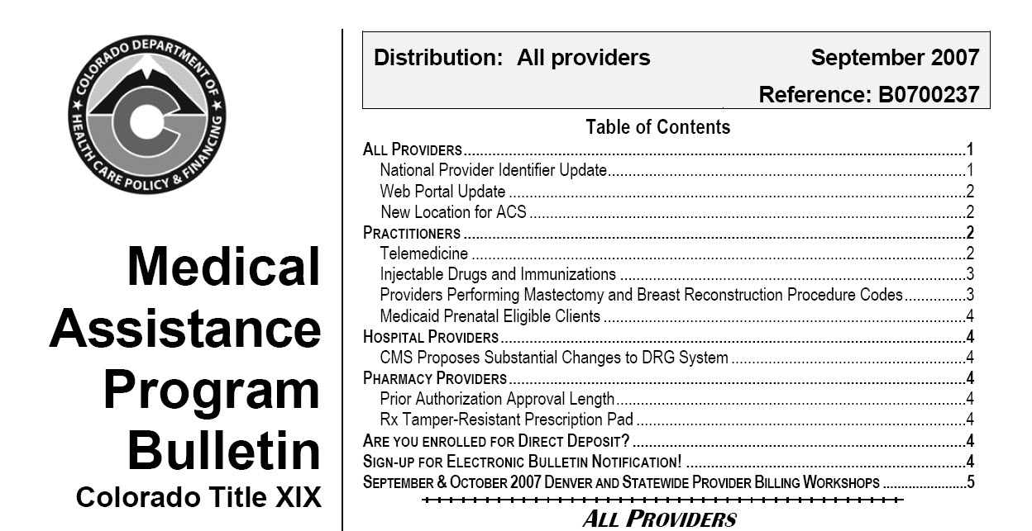

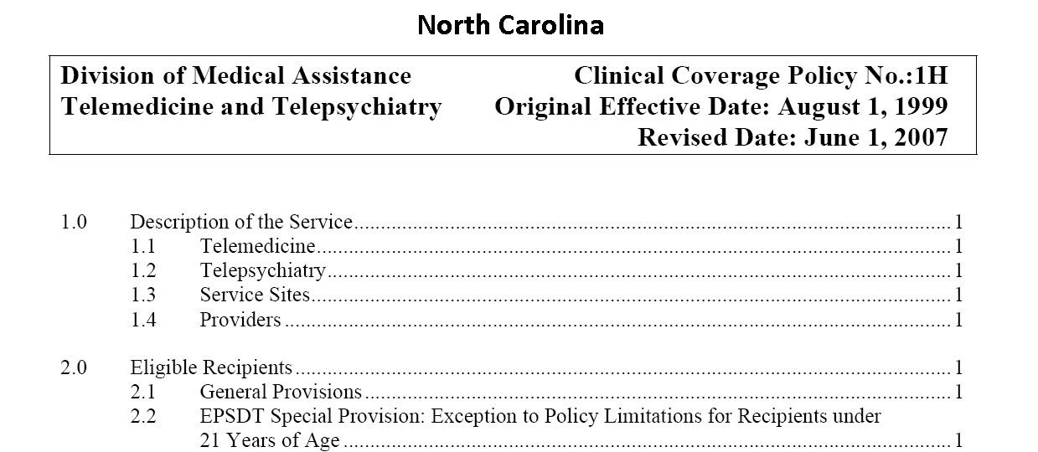

Slide 9
Stakeholder Focus
Core Service Agencies
  Included Originating Sites/Counties
  Originating Site Fee
Psychiatric Society
  Provider and patient physically located in MD, including adjacent State providers
Private Non-profit Inpatient Hospital
  Inpatient codes
University
  Originating Sites to include Schools
  Technical Requirements
  Enhanced Fee for Service Option

Slide 10
Stakeholder Process
Medicare as Basis
Foot in the Door
Evidence for TMH practice
Flexibility in Reimbursement

Slide 11


Evidence Based TeleMental Health

Slide 12
The Product
    Scope
    Definitions
    Approved Provider
    Service Model
    Eligibility
    Technical Requirements
    Confidentiality
    Medical Records
    Covered Services
    Reimbursement

Slide 13
Regulation Sections
    Scope
      Improve access/avoid ER
      Improve access/to specialty care
      Improve access/choice
    Approved Provider
      OMHC
      Individual provider
    Service Model
      Fee For Service/Enhanced Rate
    Eligibility
      Medicaid/PMHS clients
      Voluntary
      Rural Areas of MD identified by the Dept >
      Originating Sites >

Slide 14
Qualified Geographical Areas
Medicare
Health Practice Shortage Areas (HPSAs)
Non-Metropolitan Statistical Area (MSA) counties
Entities that are Federal telemedicine demonstration projects
Medicaid
State Designated Rural Geographic Area

Slide 15
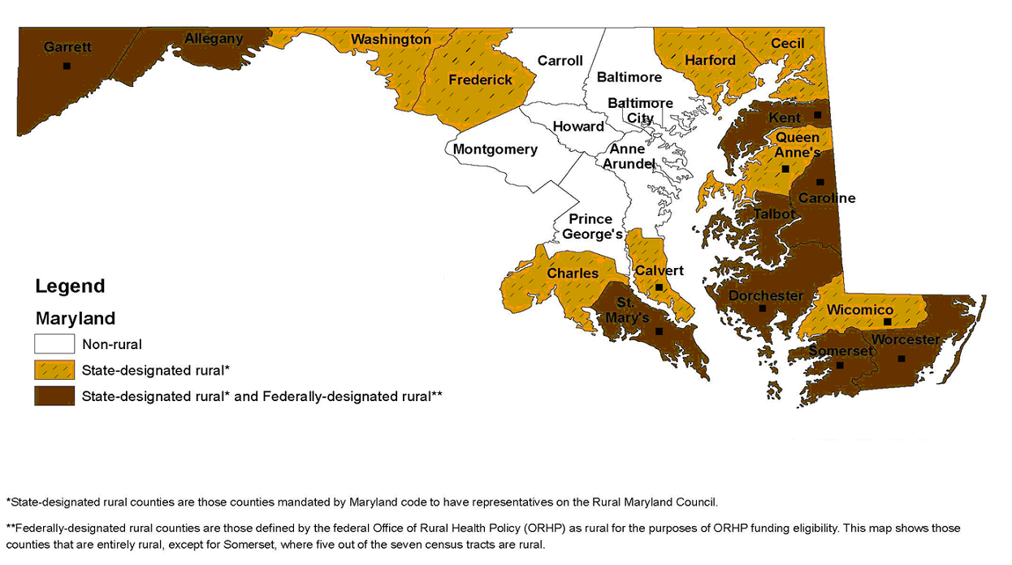
Notes:
15

Slide 16
Medicare
Originating Sites
    Physicians or practitioner office
    Hospital
    Critical Access Hospital
    Rural health clinic
    Federally qualified health center
    Skilled Nursing Facilities
    Community Mental Health Centers

Slide 17
Proposed Medicaid
Originating Sites
    Medicare Originating Sites
    Elementary, middle, high, or technical school with a supported nursing, counseling or medical office. A college or university student health or counseling office
    County Health, Human and/or Social Service offices or clinics and other county offices appropriate for private clinical evaluations and services

Slide 18
Regulation Sections
    Technical Requirements

Slide 19
Technical Requirements
1. Minimum ISDN or IP bandwidth using H.264 video protocol > 256 kbps
2. Monitor: minimum, non-anamorphic, net display size of 16" diagonally
3. Minimum resolution of 1 Common Intermediate Format/Source Input Format
4. Switched Network or Encryption

Slide 20
Regulation Sections
    Confidentiality
      HIPPA
    Medical Records
      Originating Site Maintains Complete Record
    Covered Services
      Medicare and Group/Family Therapy
    Reimbursement
      Originating Site Facility Fee
      Professional Fee
      Telepresenter Fee

Slide 21
Current Reg Status
Awaiting CMS approval
TMH Provider Application
Economy
  OMHC, FQHC, Hospitals
  No 90847 or 90853
  Facility Fee $23

Slide 22
Currently Qualified Geographical Areas
Medicaid
Garrett
Allegany
Worcester
Somerset
Wicomico
Dorchester
Caroline
Talbot
Queen Anne’s
Kent
St. Mary’s
Calvert
Charles

Slide 23
Future Direction
Vision: TeleMental Health Center of Excellence
  Clinical Champion
  Coordinator Resource
  Technical Resource
  Education, training & research

Slide 24
Future Direction
TeleMental Health Center of Excellence Funding
  Development Grants
  Research Grants
  Contractual Agreements
  Mental Hygiene Administration
  Maryland Legislature

Slide 25
For More Information on TeleMental Health
  www.telementalhealth.info >
  Maryland TeleMental Health Alliance
  bgrady@psych.umaryland.edu

