Slide 1
Maryland Telehealth Roundtable
Annapolis, Maryland December 6, 2010

Slide 2
Maryland Broadband Cooperative
Long understood problem of delivering broadband to rural Maryland
Formed by legislation in 2006 (SB 753)
The 5 Tri-County Councils are our permanent Class A Members
Focus on Promoting both Availability and Affordability
Public/Private Partnership
Middle-Mile Solution
Only entity in the state with fiber that spans the Bay Bridge
Cooperative Business Model
Cooperatives brought electricity to rural America, can do the same for BB
Built by the Users of service, for the Users of service
Cooperative profits are returned to customers through lower prices
Roughly 60 Members and Growing

Slide 3
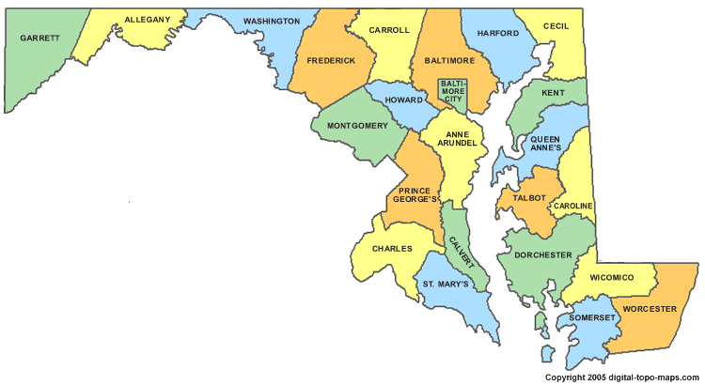
Mission Statement
Our Mission is to drive economic development through universal, open access to broadband services via a fiber optic network that serves rural Maryland by building an advanced, world-class broadband network across the rural communities of Eastern, Southern, and Western Maryland supported by its Members who provide Last Mile services.

Slide 4
UMMS Telemedicine Network
Connects 3 rural Eastern Shore medical centers with UMMC and TOC
Planned to expand to most UMMS facilities
Collaboration of 4 Cooperative Members
Extraordinary Speed and Throughput Capability

Slide 5
Telemedicine is About Speed
Slide Provided by FCC

Slide 6
Speed Needs by Delivery Setting
Slide Provided by FCC

Slide 7
Speed Needs by Delivery Setting
Slide Provided by FCC

Slide 8
What Can MdBC Do?
Wholesale lit backbone services to ISPs and Enterprise customers
50 Mg to 1G to 10G waves
Dark Fiber Leases under special circumstances
If you are a non-governmental entity:
MdBC member ISPs may compete to provide you service off our backbone
If you have Enterprise needs, MdBC may coordinate that for you directly
If you are a governmental entity:
We will help you coordinate with networkMaryland

Slide 9
Where Can MdBC Help?
There are places we can serve today with our existing network and through member partnership.
Extraordinary service area expansion in 12-18 months. Upon approval of the OMBN Environmental Assessment (Maryland’s $115M ARRA Award), MdBC will be able to offer service along significant portions of the State’s broadband network.
New backbone builds funded by the ARRA grant will make MdBC’s service delivery footprint almost ubiquitous in the 15 rural counties of Maryland. New backbone builds must be completed by Sep 1, 2013.

Slide 10
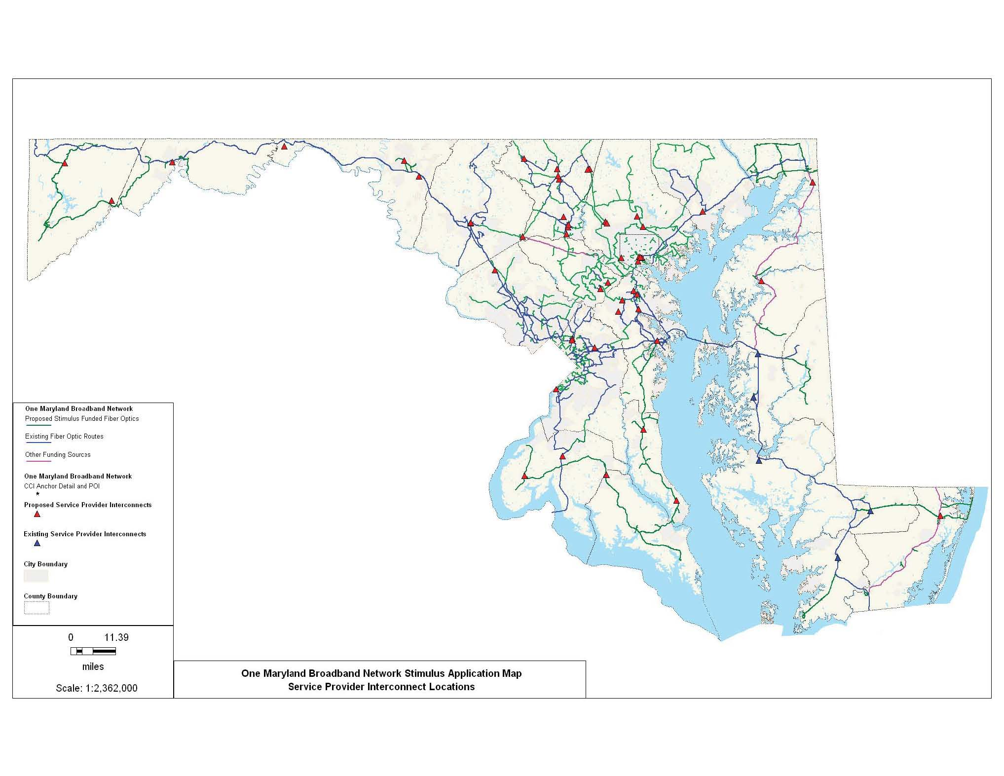
One MD Network Map

Slide 11
Questions and Answers
Drew Van Dopp,
Administrative Director
Maryland Broadband Cooperative, Inc.
dvandopp@mdbc.us
(410) 341-6322

